Slide 1
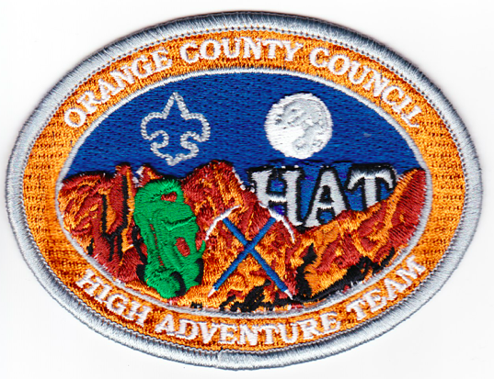
Orange County Council
HAT Training
Trail Boss – Bron Draganov

Slide 2
What is Trail building?

Slide 3
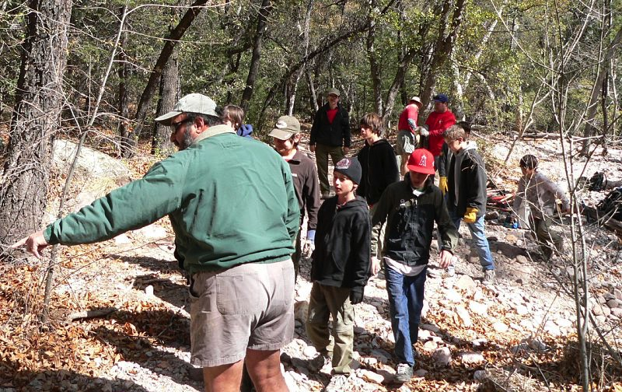
It is anything from . . .

Slide 4
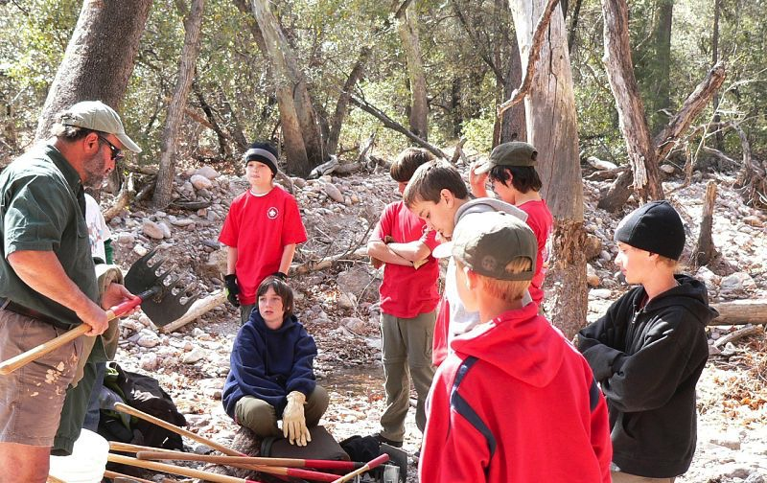
. . . clearing brush . . .

Slide 5
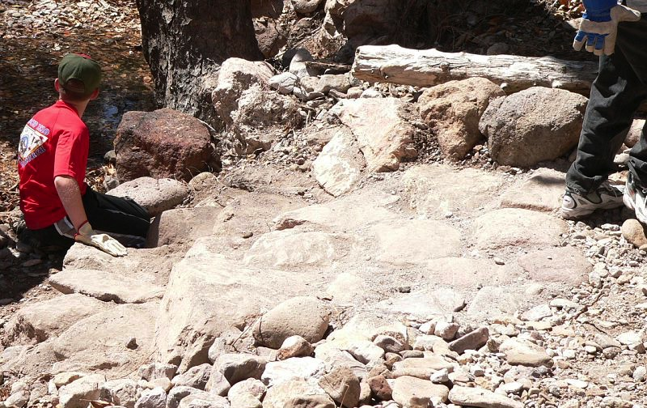
. . . to . .

Slide 6
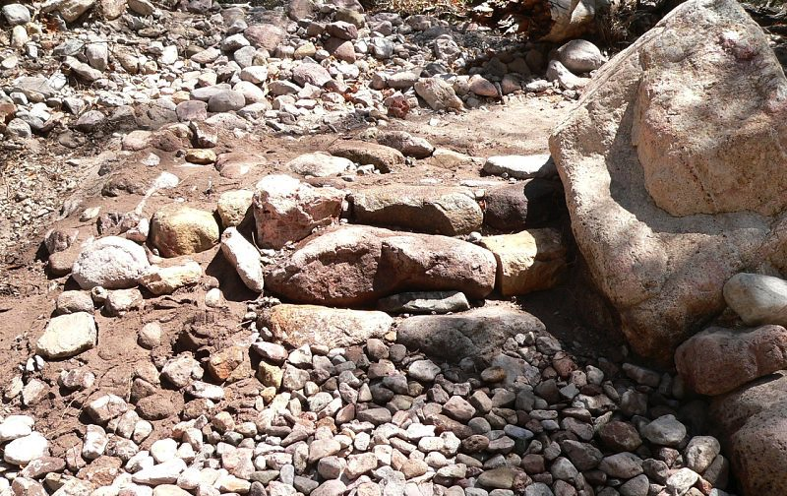
. . . setting rock steps …

Slide 7
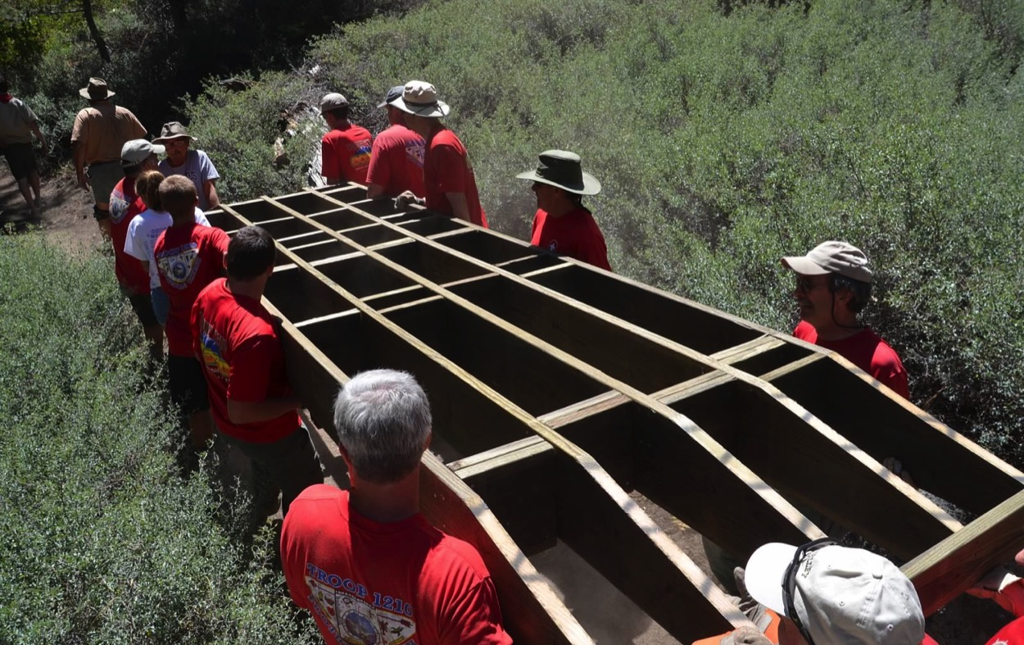
. . .to . . .

Slide 8
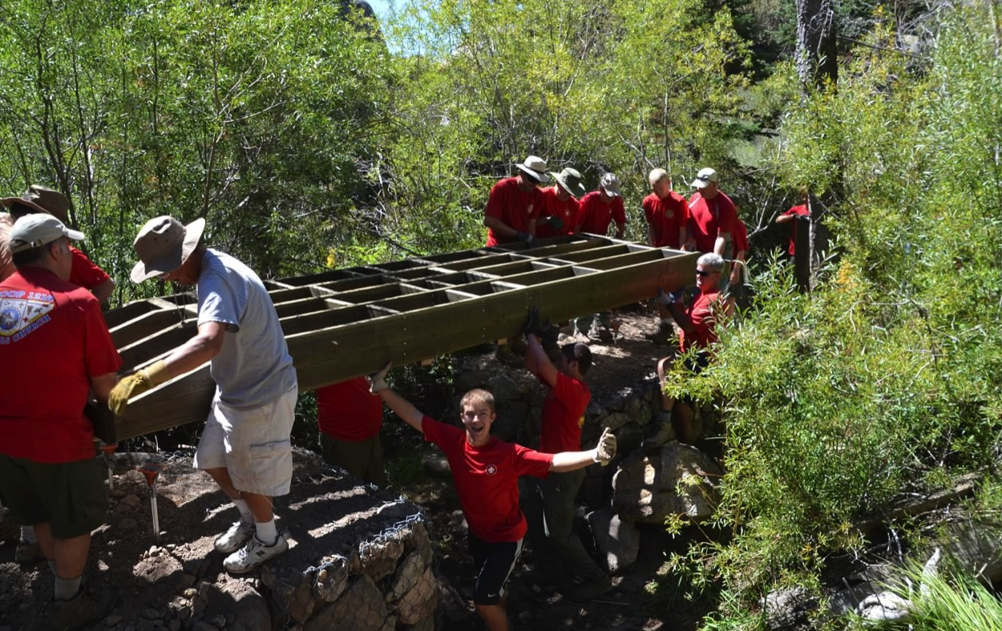
. . . Building Bridges

Slide 9
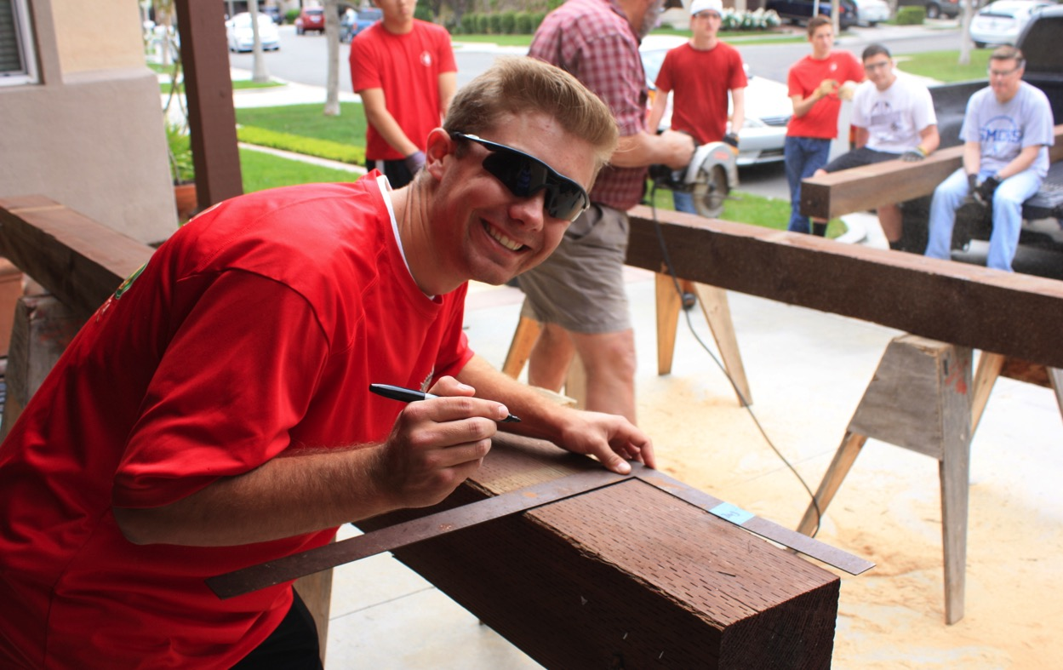
Prep Days are . . .

Slide 10
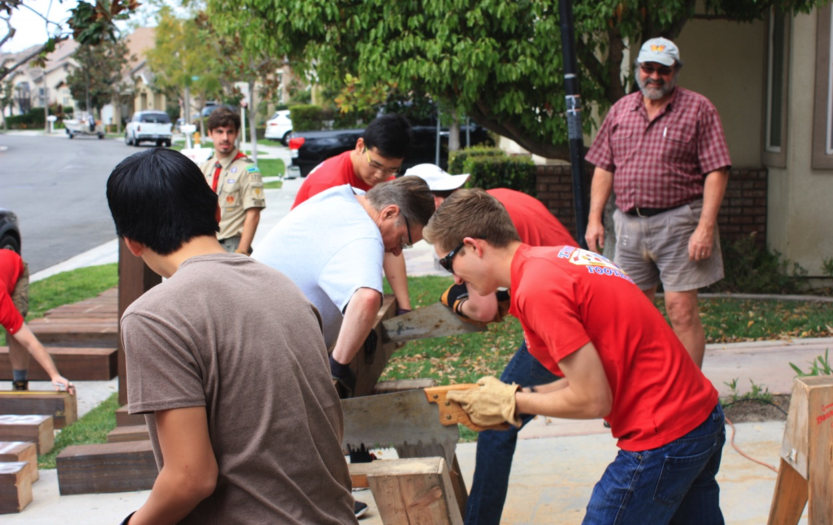
. . . are . . .

Slide 11
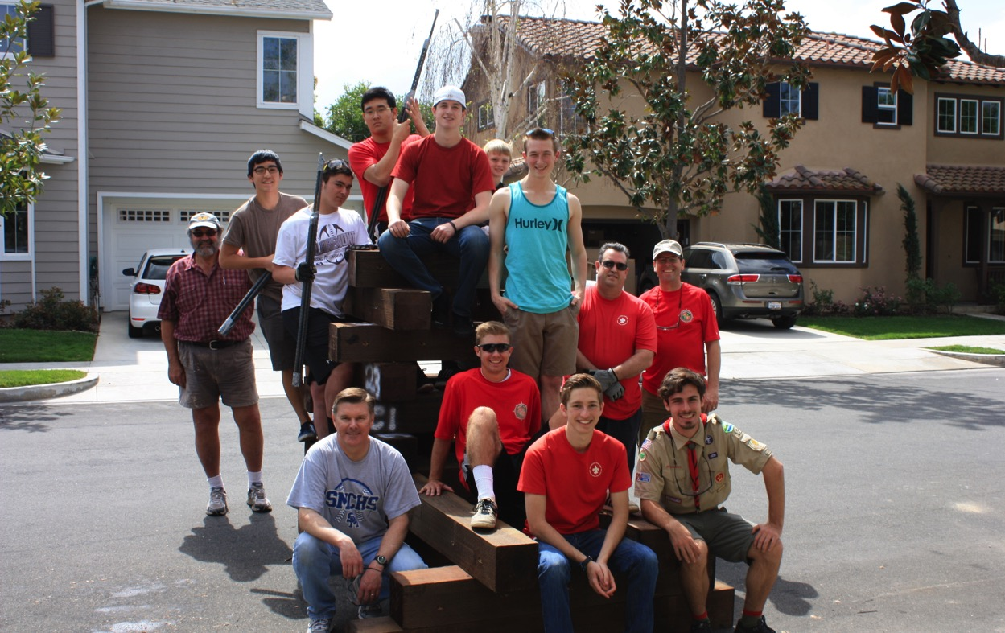
. . . always fun

Slide 12
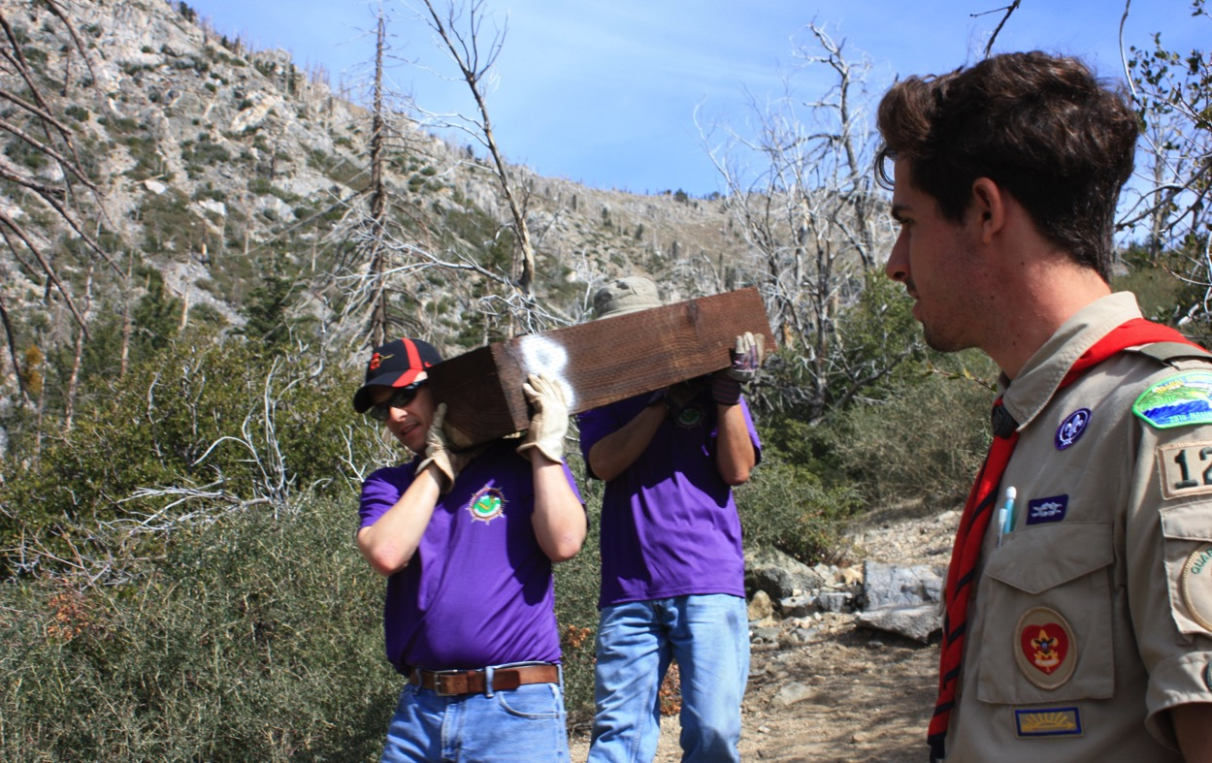
And on installation days . . .

Slide 13
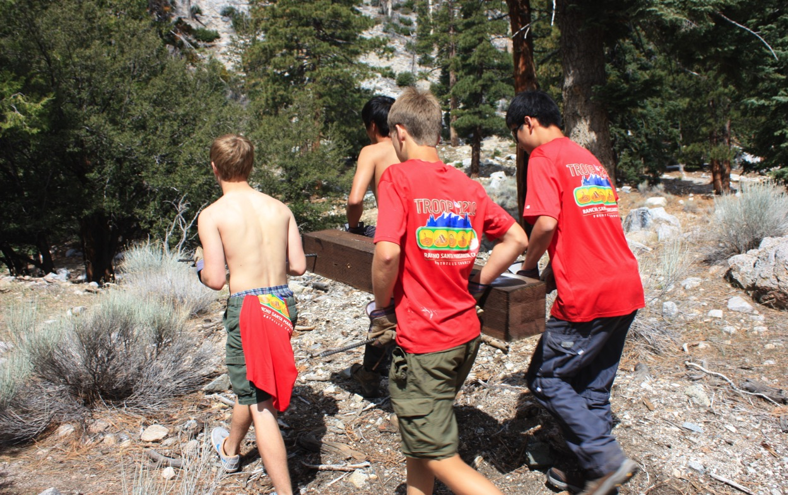
Everyone gets involved,
From Scouts . . .

Slide 14
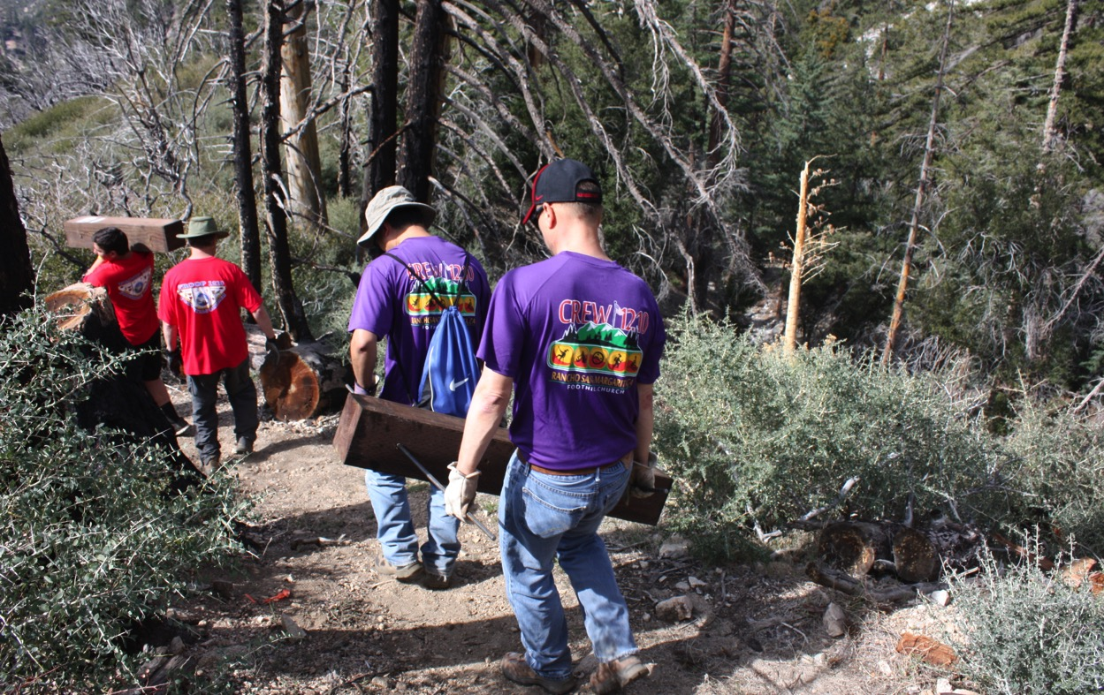
. . . To parents . . .

Slide 15
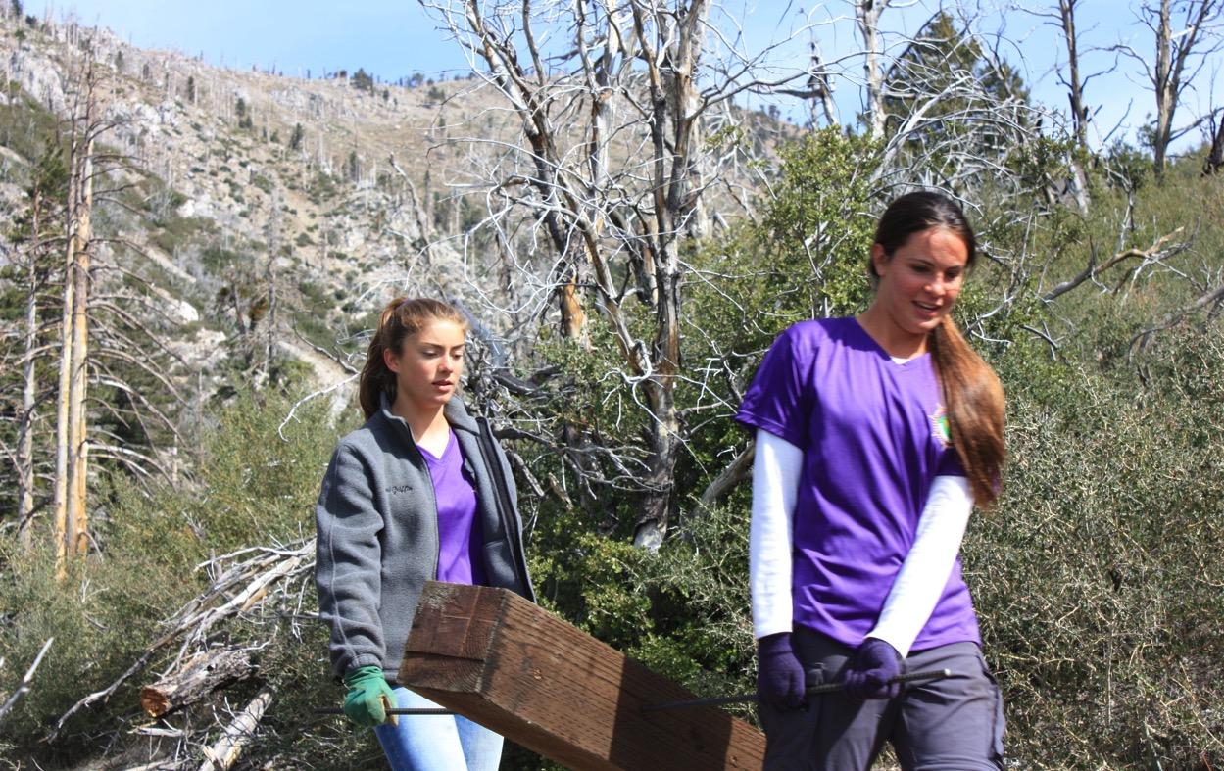
. . . And even the all girls Crew

Slide 16
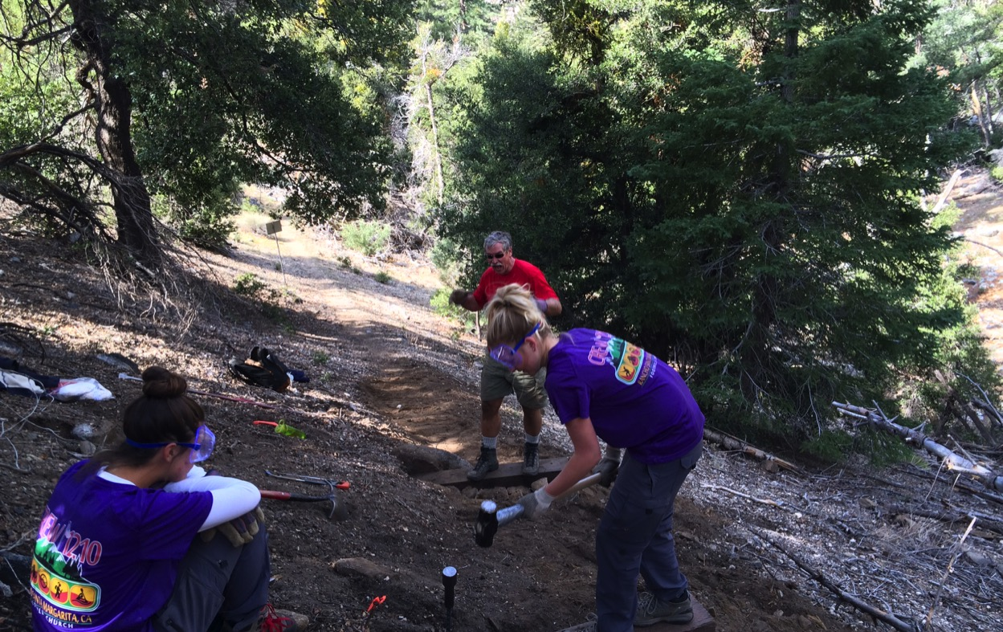
Installing 27 wood steps

Slide 17
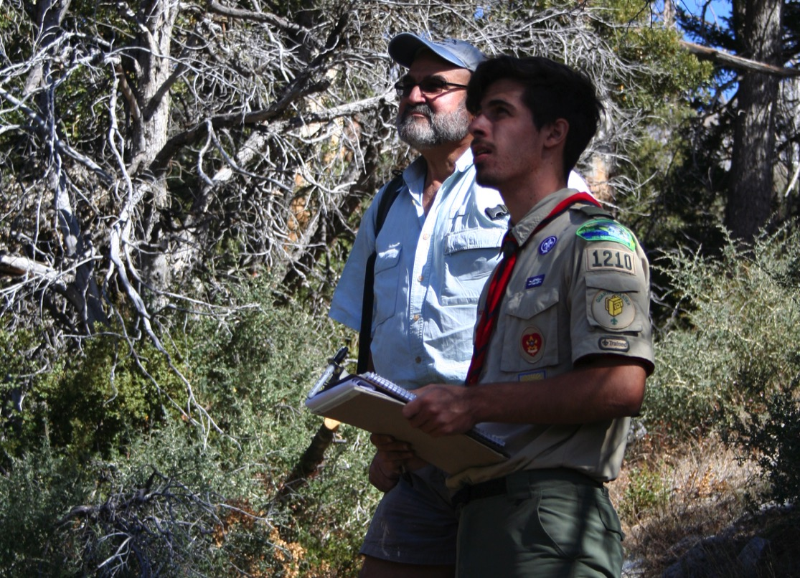
Trail Building projects make . . .

Slide 18
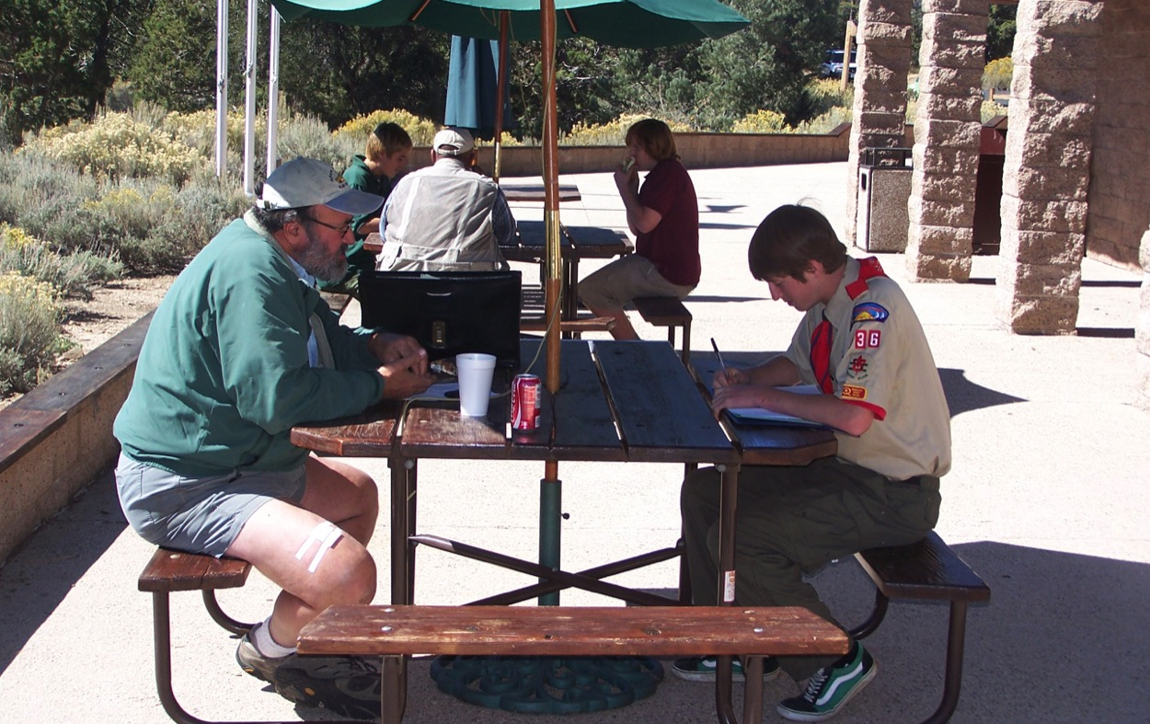
. . .for great Eagle Projects

Slide 19
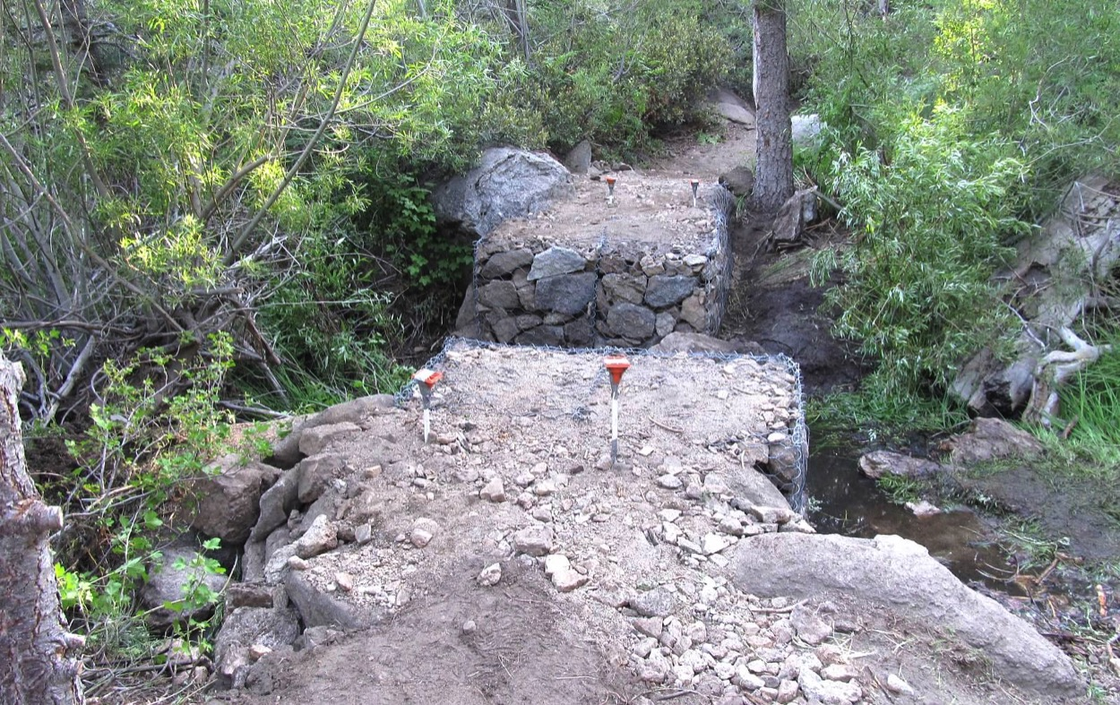
Helping to build a firm foundation

Slide 20
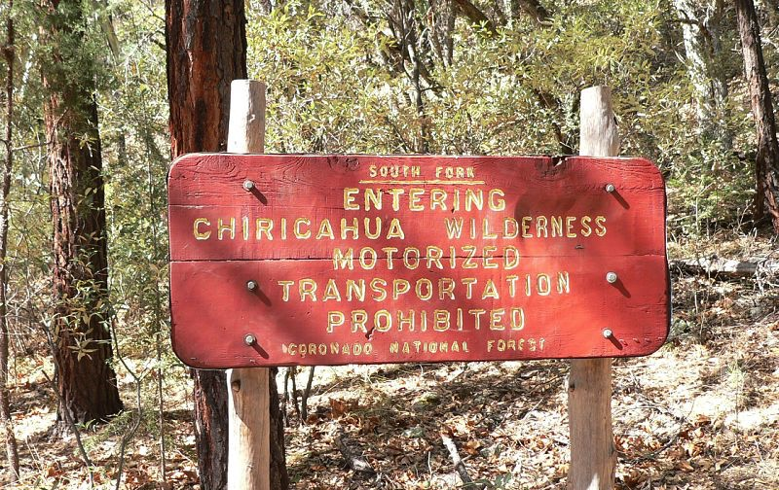
From California
To Eastern Arizona

Slide 21
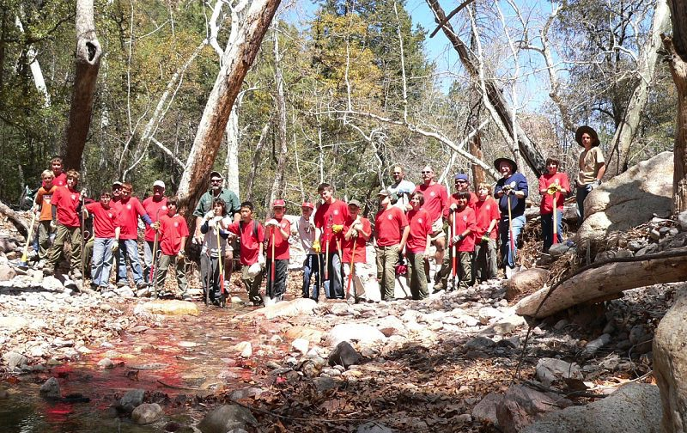
Many hands lighten the load

Slide 22
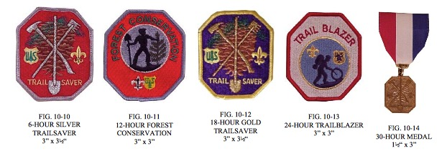
OCC HAT Training - BBC
Trail Saver
Los Angeles Area Council

Slide 23
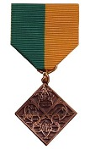
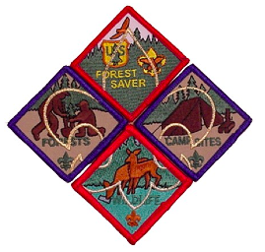
OCC HAT Training - BBC
Forest Saver
Los Angeles Area Council

Slide 24
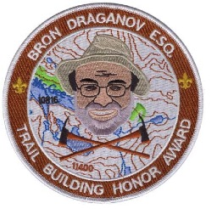
OCC HAT Training - BBC
Bron Draganov Award
Orange County Council

