Slide 1

Suggestions on First Aid Preparedness

Slide 2
Personal Wilderness
First Aid Kit
Barrier for mouth-to-mouth
2+ pairs medical gloves
Gauze pads and sanitary napkin or ABD pad
Baggies
Roller gauze (2 or 3 inch), triangular bandage
Moleskin, medical tape, bandaids
Soap
Scissors, safety pins, tweezers
Pencil and paper
OTC and prescription medications as appropriate

Slide 3
Do I Need First Aid Training
Beyond Standard First Aid?
Desired Outcome | First Aid Course
Treat basic FA issues such as blisters, cuts and sprains | Red Cross Standard First Aid or equivalent
Capably treat patients with single obvious injuries such as sprains or fractures | SOLO (REI) or ARC/BSA 16 hour WFA course
Direct other first aiders or work as a solo first aider on serious or multiple injuries | WFAC (26 hours) or WMA, WMI, SOLO or NOLS WAFA (36 hours)

Slide 4
ARC/BSA Wilderness And Remote First Aid in OC
South San Clemente – Saturday, Sunday on one weekend
  Contact Jeff Johnson at jbrooksj@cox.net for more info
Fullerton– Saturday, Sunday on one weekend
  Contact Greg Arnold at grega.crew93@gmail.com for more info

Slide 5
ARC/BSA Wilderness And Remote First Aid in LA
Glendale – January and October
Two successive Saturdays
Course fee is approx. $40
Current CPR is required
Contact Marlene Lugg at mmhlugg@alumni.pitt.edu for more info

Slide 6
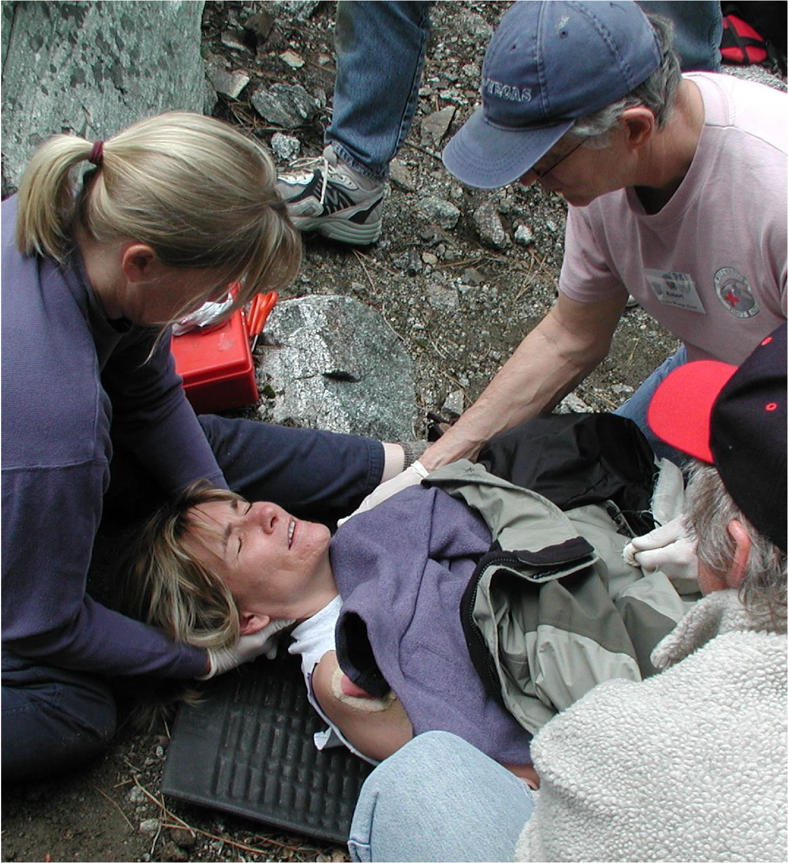
Wilderness First Aid Course
Three day course (Fri - Sun) taught at lodge on Mt. Baldy
Courses are May 3-5 and Nov 1-3
Recognized by Nat’l Sierra Club, Philmont Scout Ranch, OC HAT Leader Training
$305/$315 fee includes food and lodging
CPR prerequisite (training within 4 years)
Applications on the website - www.wildernessfirstaidcourse.org
Seeking kitchen staff – work to earn free tuition; need experience cooking for large groups
© 2013 WFAC

